Slide 1
Global electronics-report

Slide 2
Profit based on products
The product analysis based on profit shows which product has yielded the most profit from the observed sales.
As the conclusion of product analysis we come to know that the “Desktop” product has yielded the most profit especially the WWI black colored.

Slide 3
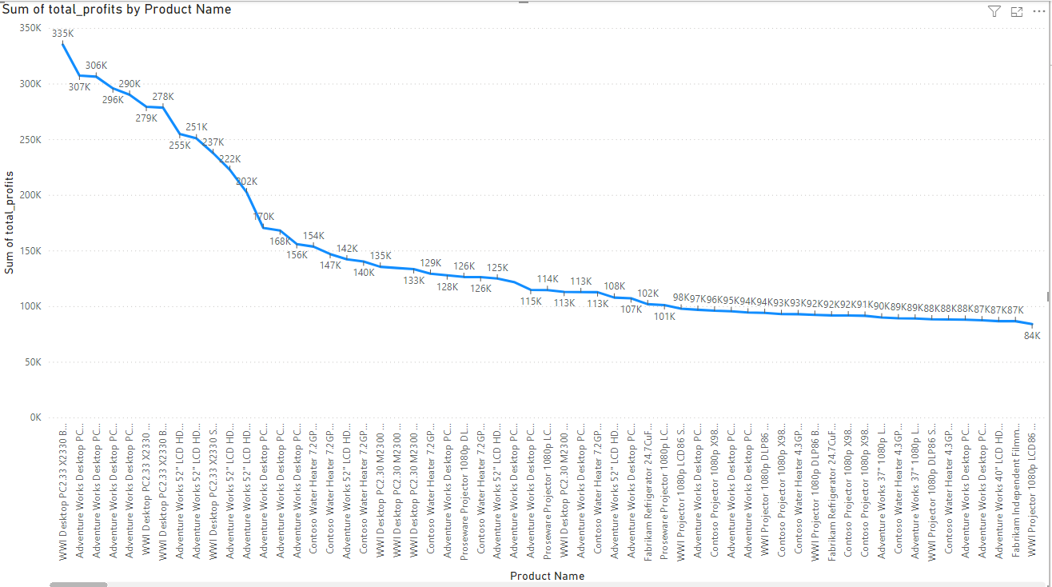

Slide 4
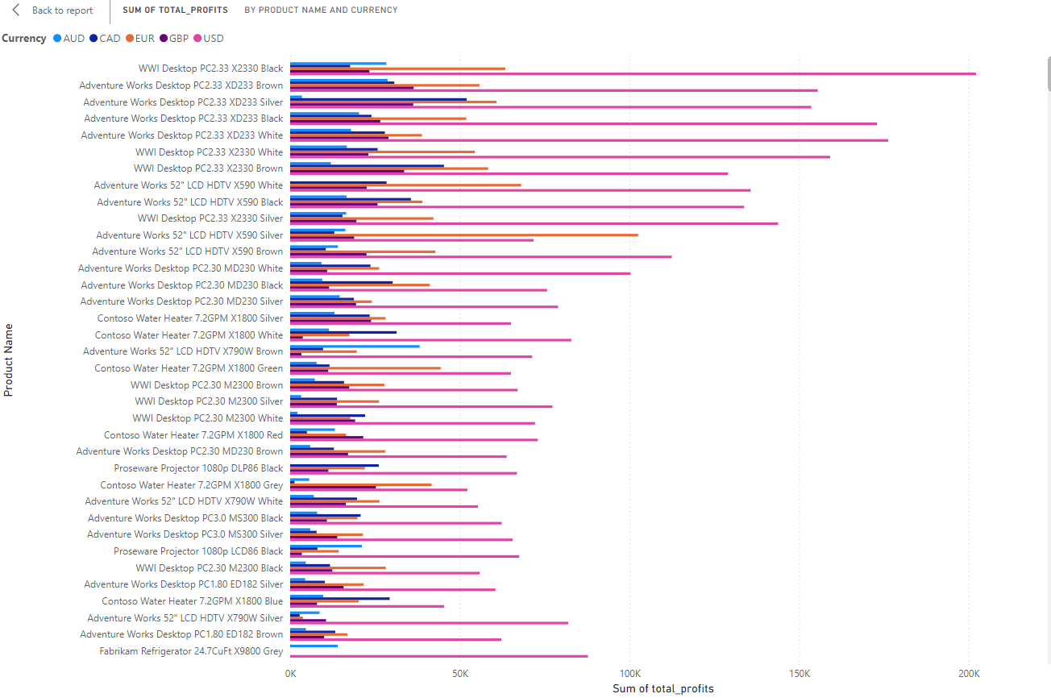

Slide 5
Popularity of the products based upon age range
This concept basically allows people to see that the most bought product with the age bias.
What are all the products that are bought by the people based on age?

Slide 6
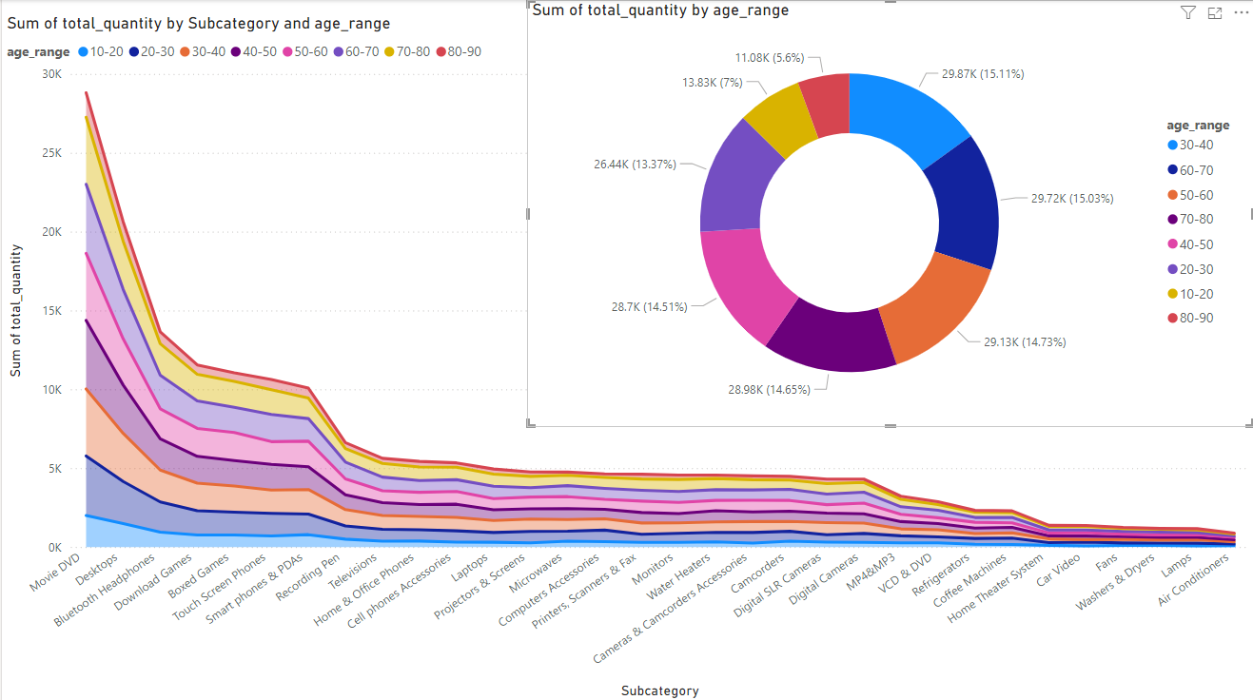

Slide 7
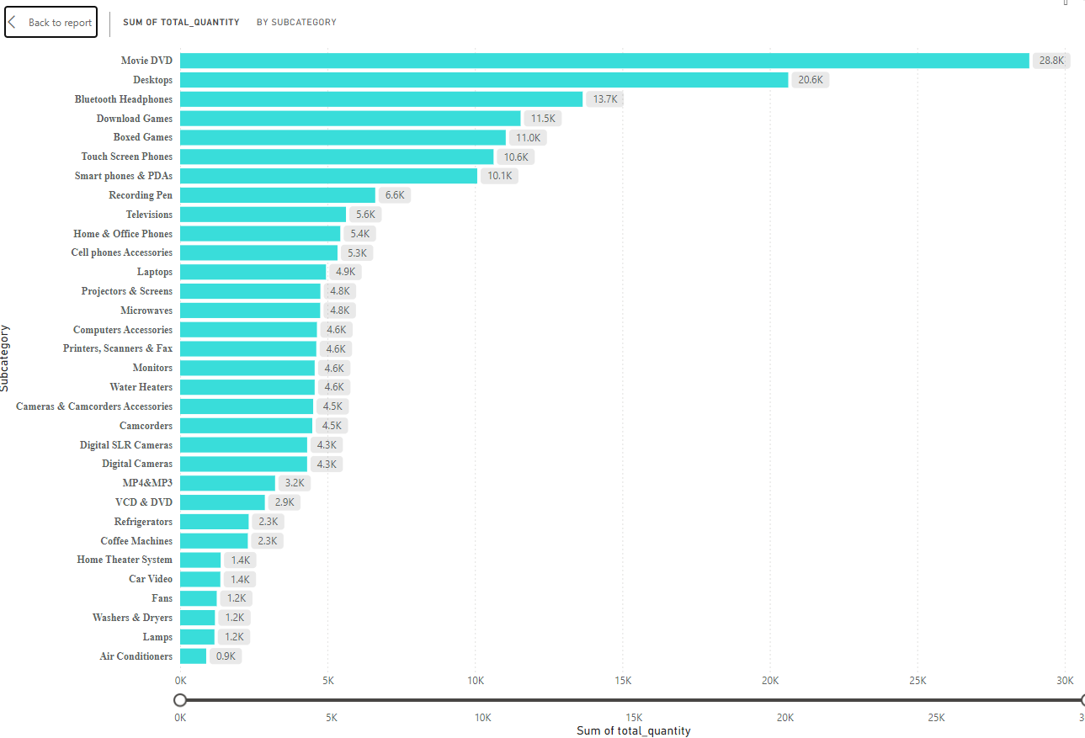

Slide 8
Popularity of the products based upon age range
From the above reports we can clearly picturize that the people at the age range of 30-40 has been the customers that bought most of the products.
The most bought product is the DVD and the least bought product is the air conditioner.
As we can see that laptops are sold on a lower quantities we can ensure that we can apply a Student’s Discount for laptops which can boost up the sales as the academic year is about to start so that we can make the people of age 20-30 to buy the laptops.

Slide 9
sales based on the country
The sales based on the country can be evaluated by the amount of products purchased by the people of a country.
Which country has the most customers?
Let’s find out….

Slide 10
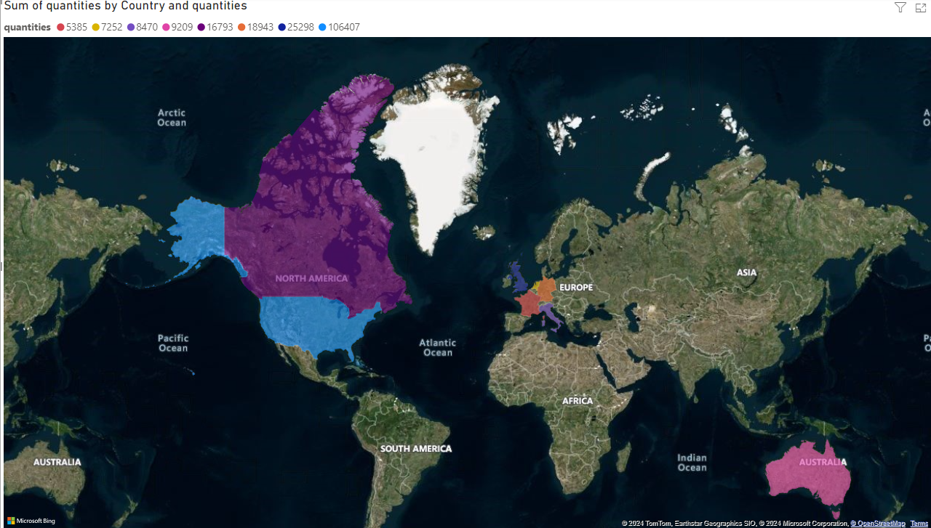

Slide 11
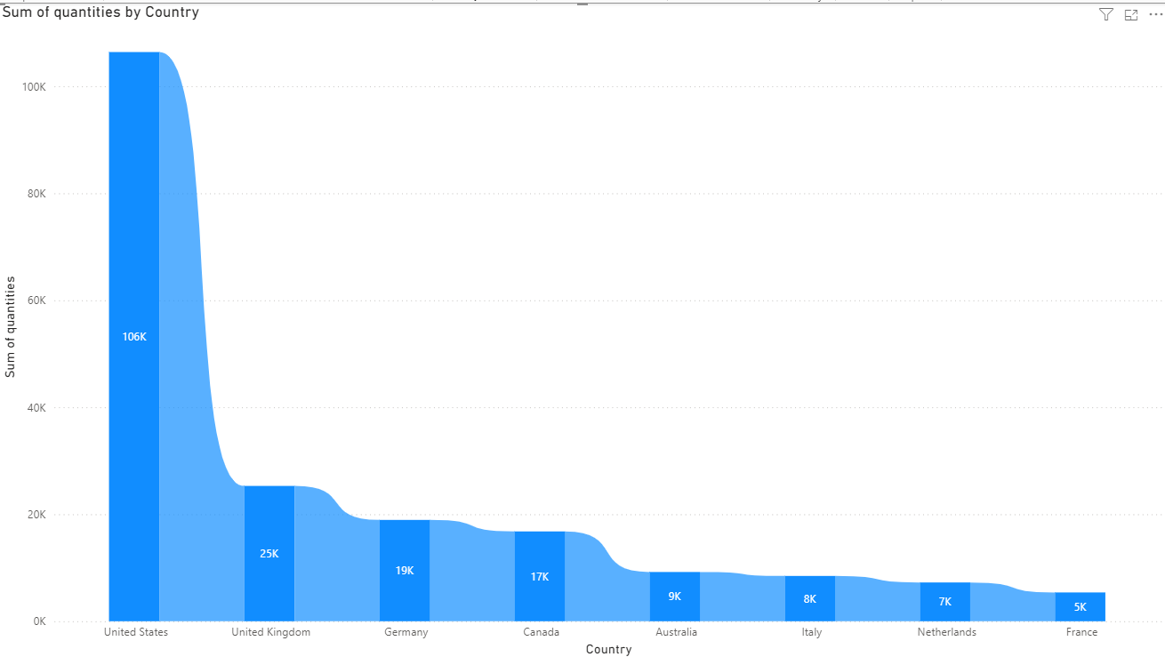

Slide 12
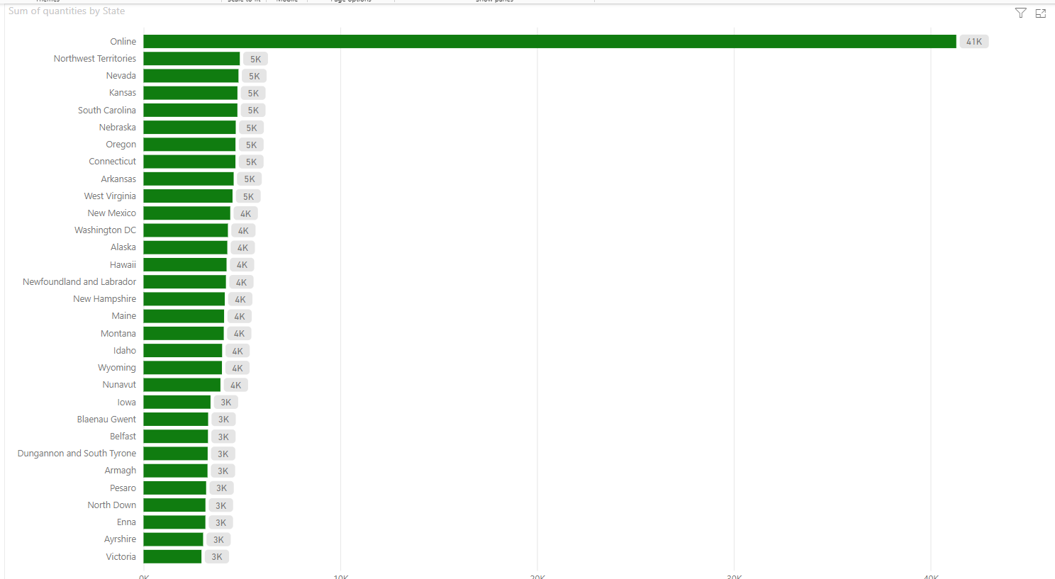

Slide 13
sales based on the country
As clearly organized the most purchases has been done by the US people.
The South America , Greenland and the Asian countries are untouched as new, to improve that we can conduct campaigns in order to let them know that we are selling products .
Since most of the products are sold in the online platforms rather than the offline stores it’s better to get a warehouse.
Can get a warehouse in most of the countries to let the shipments arrive there and cut-short the amount of time it takes to be delivered.

Slide 14
Sales based on gender
The study shows the interests of the people on the products based on gender bias by comparing the total purchases done by male and female separately.
Who would’ve bought more?
Let’s find out……

Slide 15
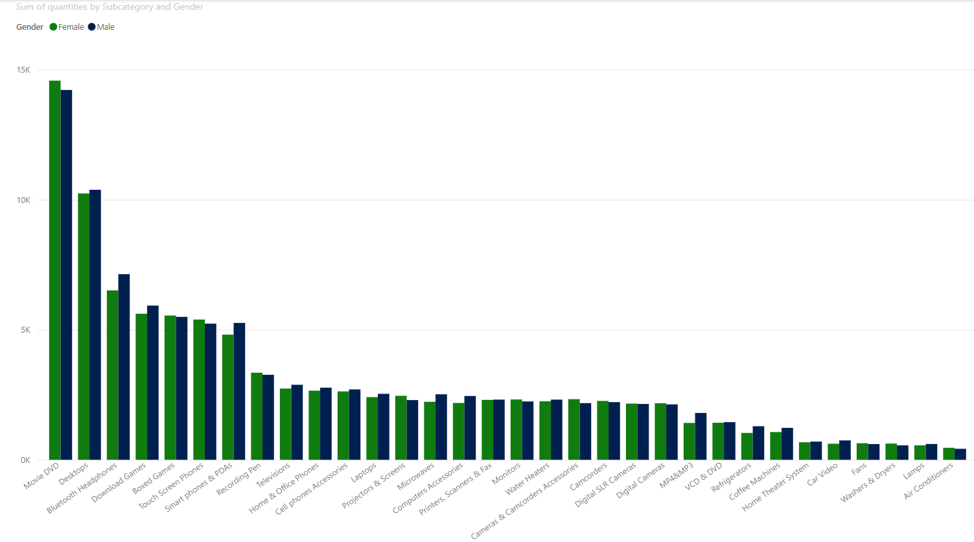

Slide 16
Sales based on gender
From the above data we can see that most of the sales were went neck to neck but the total purchases by males surpasses the female purchases only by little amount.
We can try to make this equal by introducing new products that are widely used by females.(eg: Hair dryer, straightener, etc…..)

Slide 17
Sales by brand
The study shows the sales details of the appliances in a brand category.
Let’s find out which brand has sold most?

Slide 18
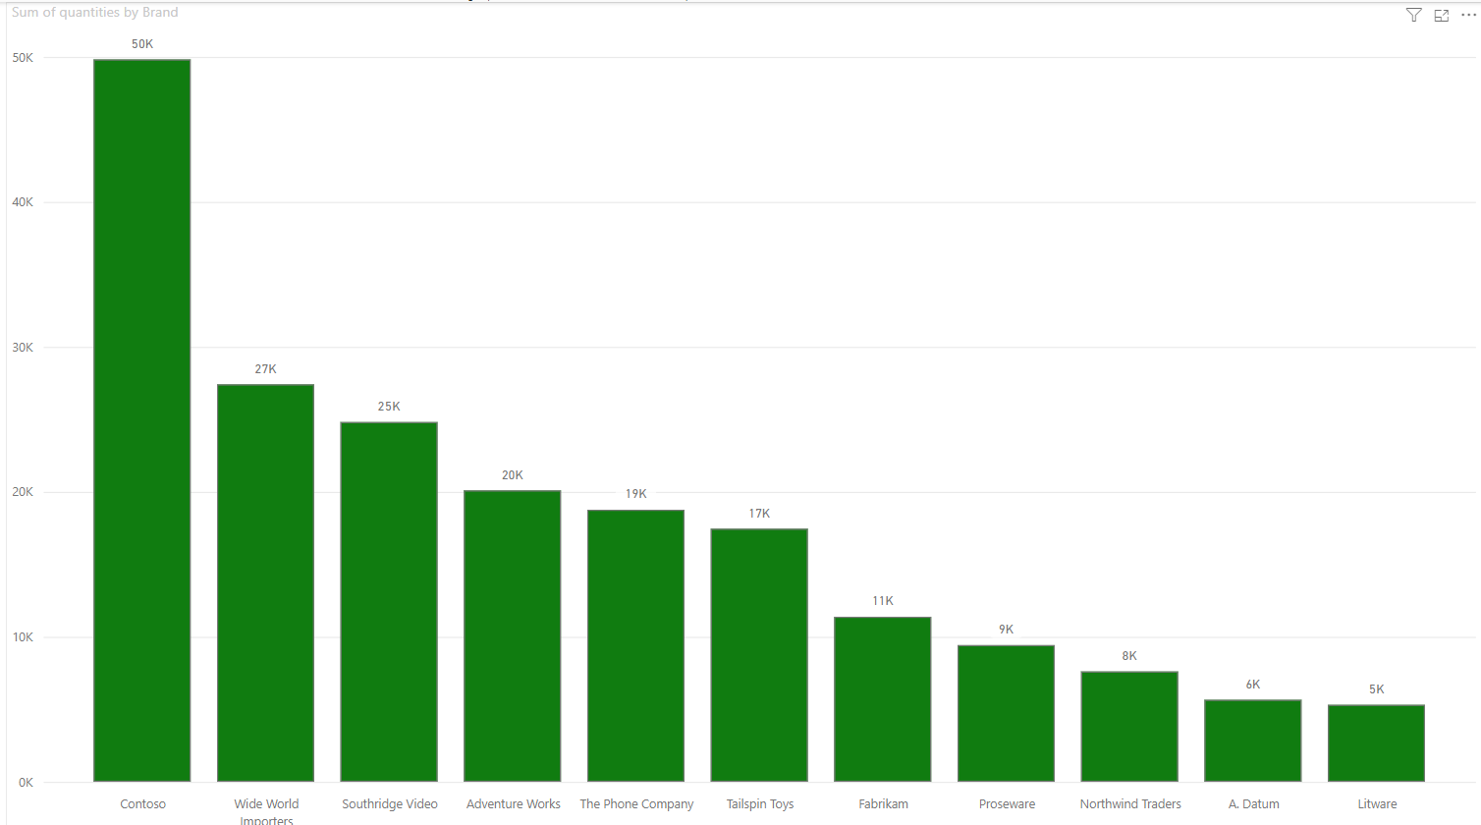

Slide 19
Sales by brand
From the above shown data we can come to a conclusion that the most sold brand is the Contoso and the least sold brand is Litware.

Slide 20
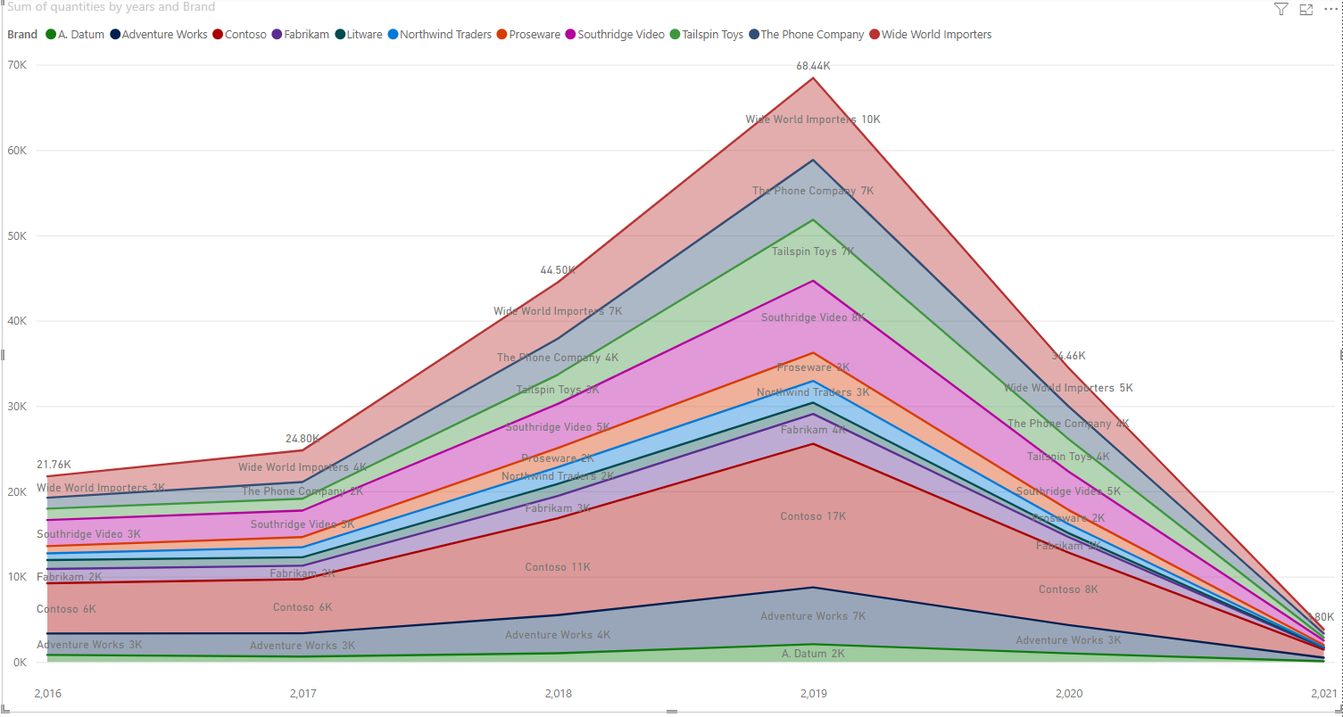
Products sold by brands in years

Slide 21
Sales by brand
From the data of sales observed we can summarize to the points
Sales was at the peak in 2019.
After that there is a tragic fall the product sales and maximum amount of products sold in the year 2021 is roughly about 3797.
We can see that the sales went from 68k to 3k in just 2years.

Slide 22
Profits made by brands
The model shows the amount of profits made by selling products based on brands
Which brand has yielded more profits ?
Let’s find out……

Slide 23
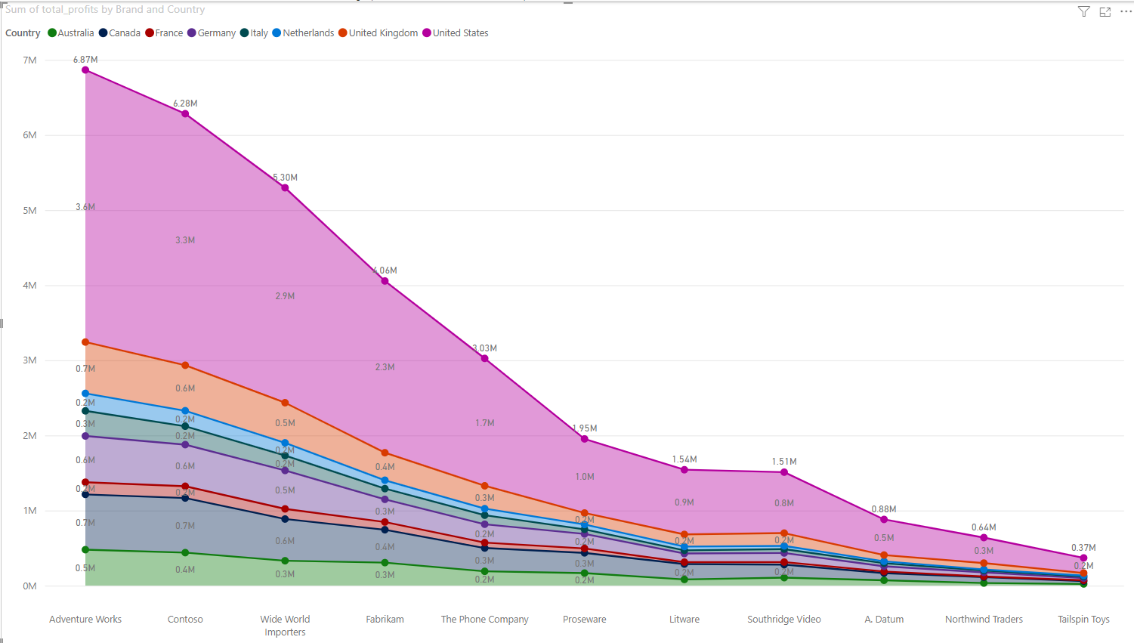
Profits based on Brands in countries

Slide 24
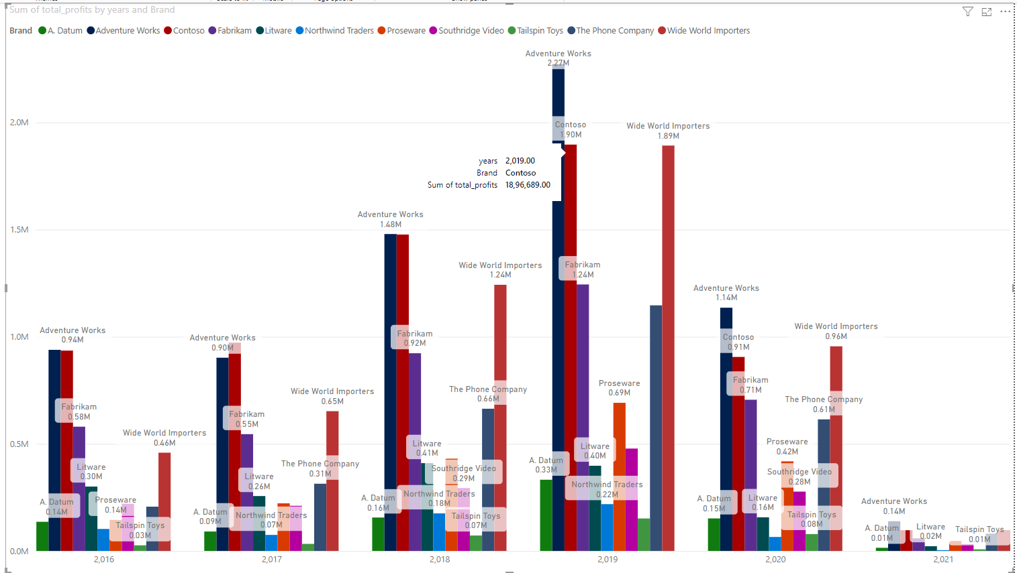
Profit made by brands in years

Slide 25
Profits made by brands
From the give data we can see that the brand that had most profit is adventure works in the United States.
As we can see that the profit has declined in a significant level through the past years as there is massive amount of reduction sales.

Slide 26
conclusion
As we have gone through the data here are the points to be improved in a nutshell
More advertisement is needed but only a reasonable amount.
Have to increase the sales margin to Asian, south American, Greenland and African countries.
To increase the sale of laptops a student discount can be given.
More of a women related appliances like hair dryer, straightener etc…. Can be put up for sale.
Room heaters can be added.

